Slide 1

PipeWan

Slide 2
https://youtu.be/v167m6KGQHU https://teams.microsoft.com/l/team/19%3amoMaahQ2VrS1Lo3A0hLzwMOlwJud9x0QL_ByEuXYBeY1%40thread.tacv2/conversations?groupId=38b325c3-f215-41b6-a9b9-5c90610e0da9&tenantId=e05b6b3f-1980-4b24-8637-580771f44dee

Slide 3
Group Members
Aron Wiley, CS
Edgar Chavez, CS
Alex Rossillon, CS
Mohammad Daoud, CE

Slide 4

Project Overview
Monitor
Our goal is to monitor the temperature and flow rate of water inside pipes
Warn
Give building owners an early warning for errors
Action
Stop pipes from freezing

Slide 5
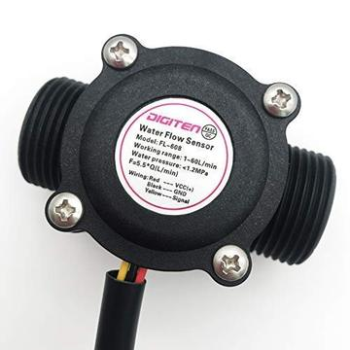
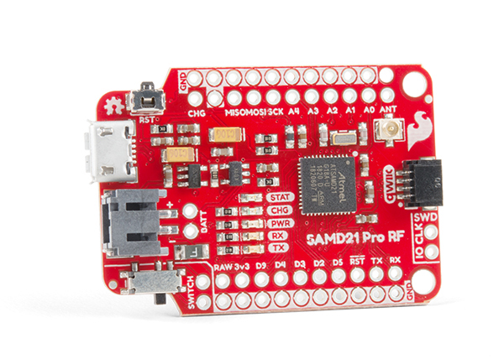
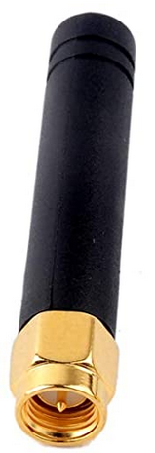
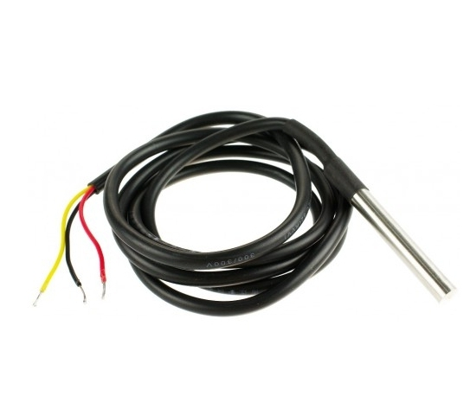
Hardware
SparkFun Pro RF
A LoRaWan ready Arduino module
Temperature Sensor
Gikfun DS18B20
Flow sensor
DIGITEN G3/4"
Antenna
8 cm omnidirectional antenna

Slide 6
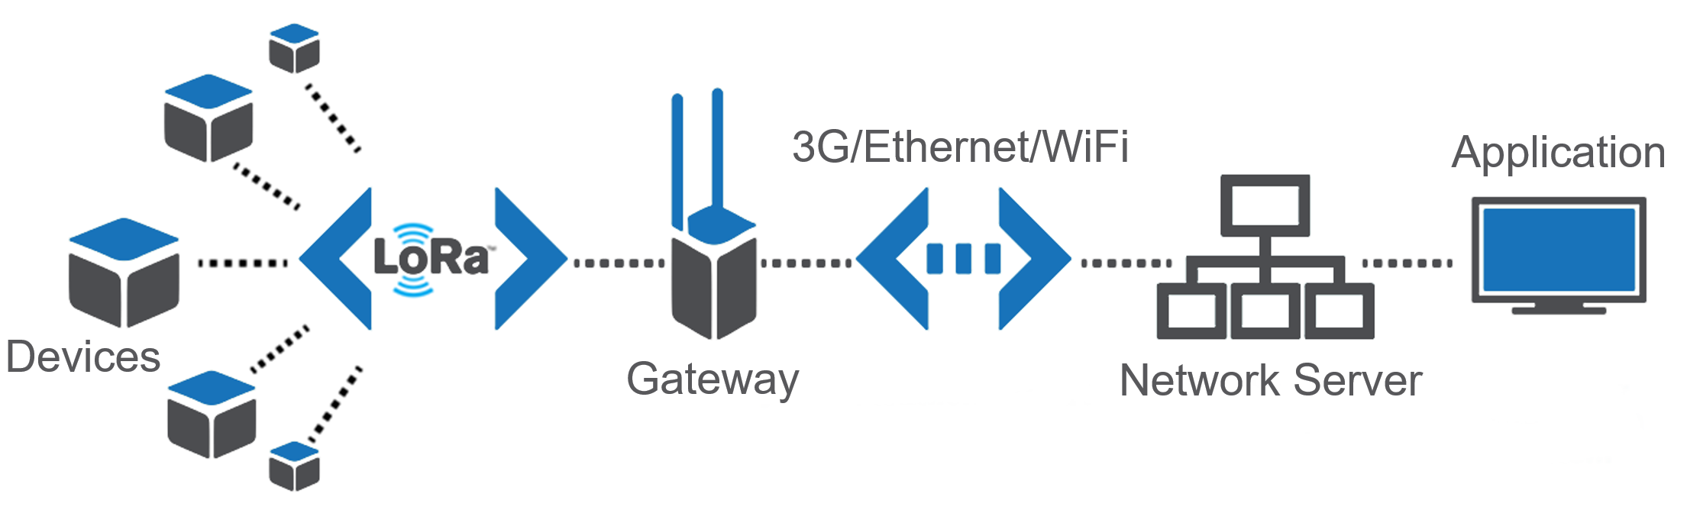
The LoRaWan Network
LoRa is used to set up communications between LoRa devices
A gateway serves as a bridge to connect LoRa to any other network becoming LoRaWAN
The network server recieves traffic from the gateway and manages the entire network.
The application will process and display the information received from nodes, and initiates downlink messages towards the end-devices

Slide 7
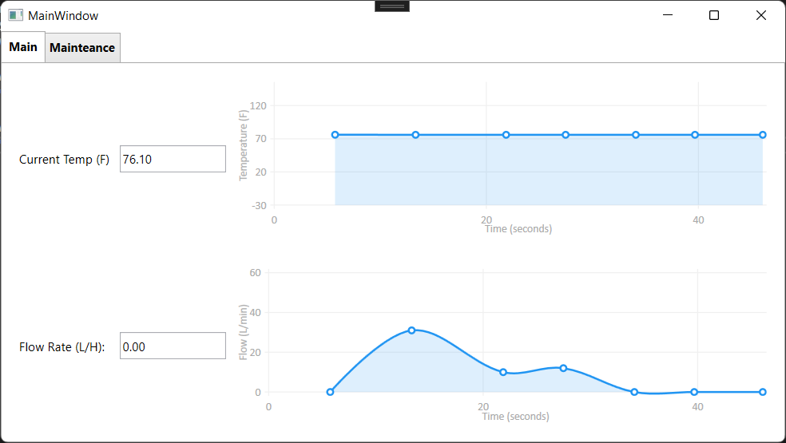
Computer Program
Receives information from Arduino via serial port
Displays current information using LiveCharts
Long-term data stored in MySql server

Slide 8
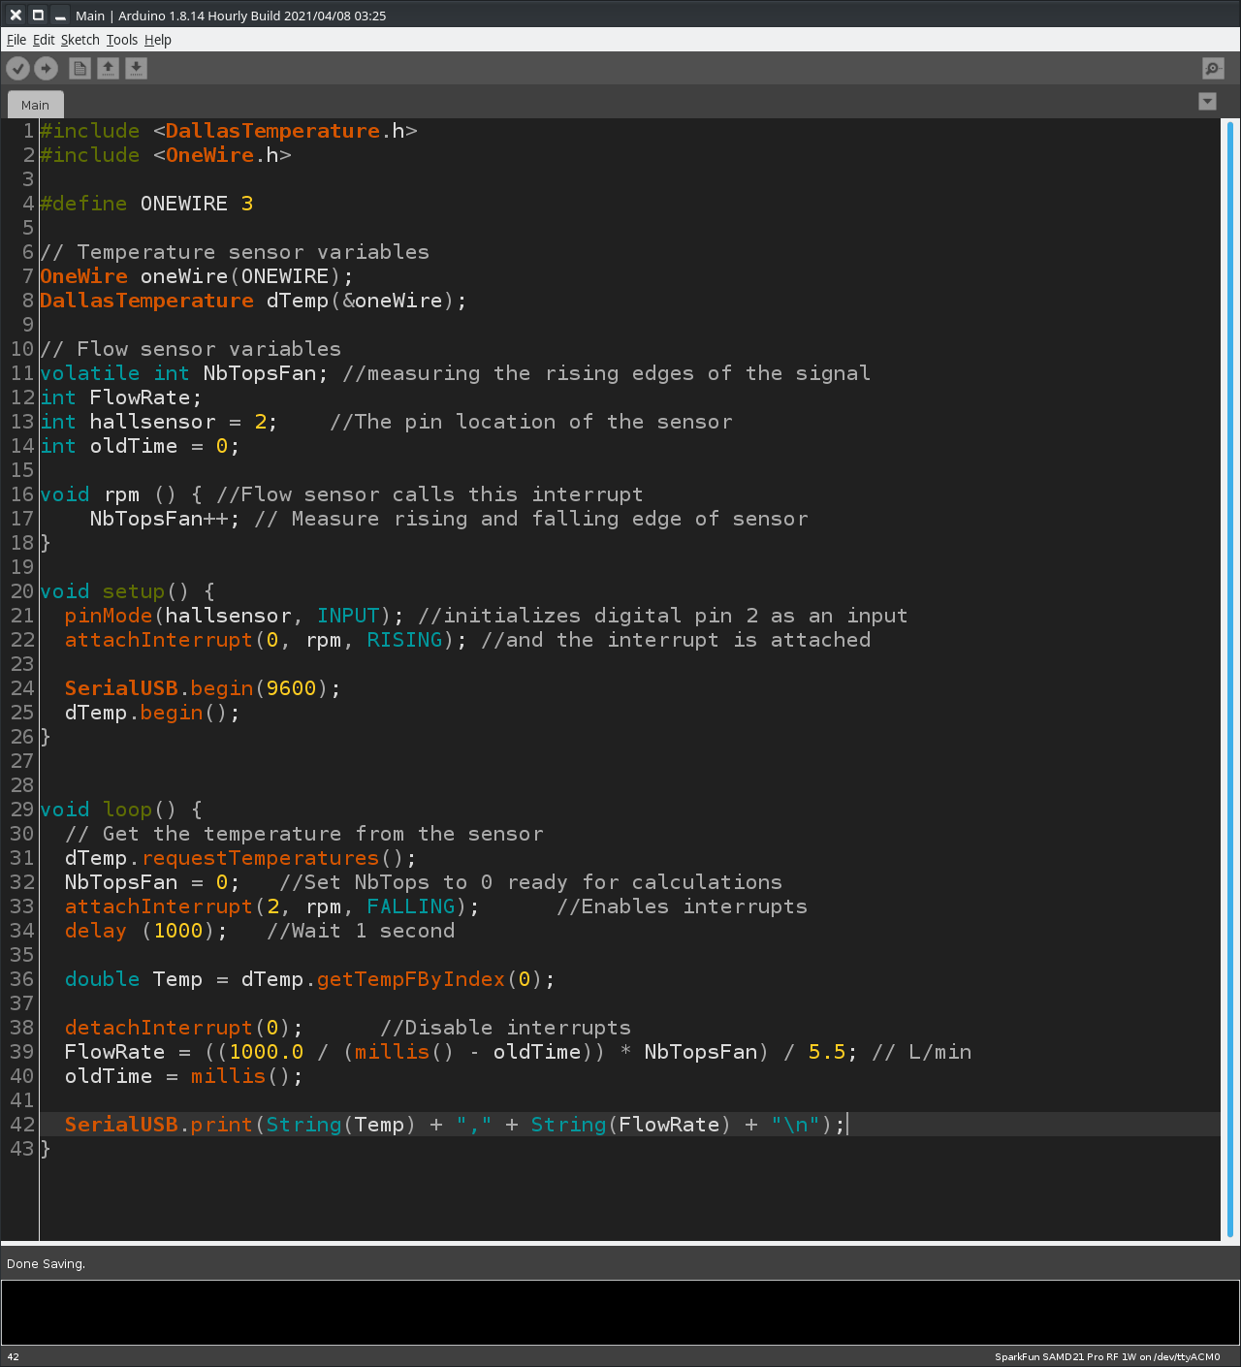
Arduino Program
Collects data from sensors
Collection rate varies depending on readings

Slide 9
Moving Forward
Scalability
Flow sensors
Design Antennae in compliance with US902-928
Connecting with large-scale pipes in buildings
Provide constant power to nodes with redundant supply
Enlarge physical size for all design components
General improvements such as code optimization, adaptive data rates, and UI and case beautification
Integrating with LoRaWan Server
Use existing Gateways and Network servers for OTAA activation.
All nodes will be visible and managed in the ChirpStack

Slide 10
Moving Forward
Software
Add email notification service to users
Connect to the existing LoRaWan network in the John Bardo Center (JBC)
Refine the processing and display of sensor data via MQTT
Possibility of adding pipe shutdown feature
Depending on its feasibility, we want to implement a pipe shutdown mechanism if conditions trend towards failure.

